Slide 1
DDS Analytics
Nicole Norelli
Presentation link
Notes:
Talent management solutions
Primarily focus on Factors leading to attrition
Models to predict attrition, monthly income
Additional observations and trends

Slide 2
Attrition Overview
140 Separated vs 730 Retained
First Impressions of Separated Employees:
Mean age: 34 (vs 37)
Mean monthly income: $4764 (vs $6702)
50% are Single (vs 27%)
Mean years at company: 5 (vs 7)
But, are these meaningful?
Notes:
For our analysis we were provided:
Data set of 870 employees
35 variables
Meaningful to predict or vary by chance?
Answer – examined each of the 35 & relationship
Breakdown top 6

Slide 3
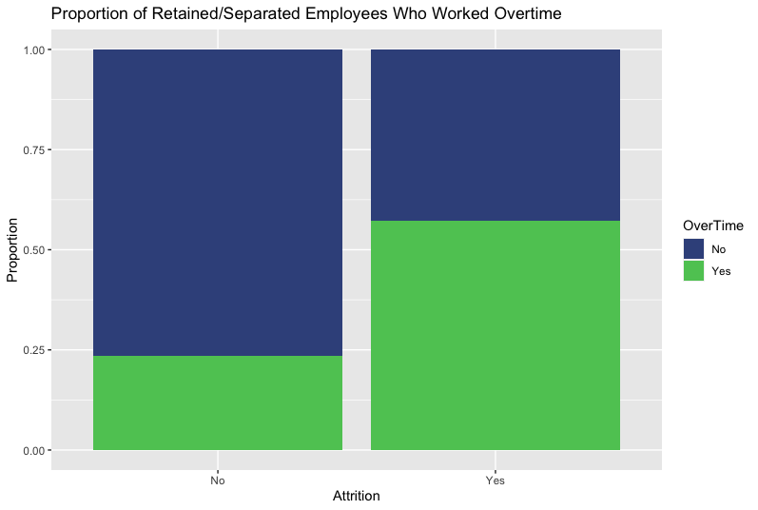
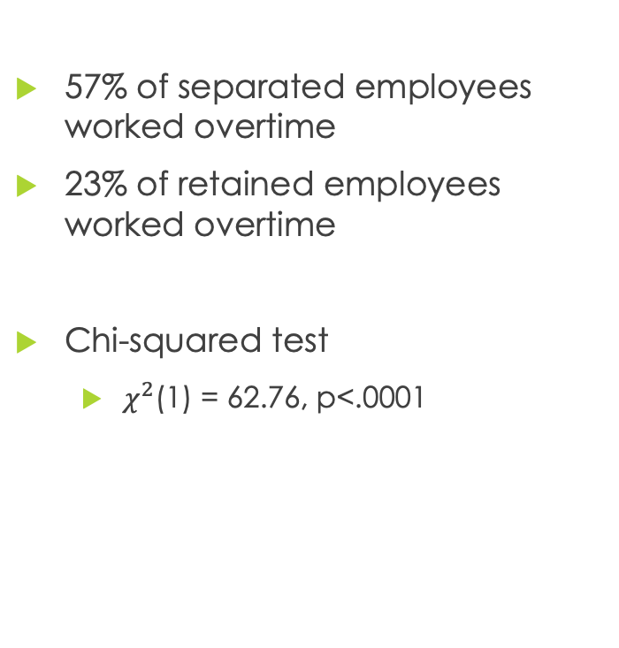
Attrition & Overtime
57% of separated employees worked overtime
23% of retained employees worked overtime
Chi-squared test
$χ^{2}$(1) = 62.76, p<.0001
 | No | Yes
No | expected: 518 observed: 558 | expected: 99 observed: 60
Yes | expected: 211 observed: 172 | expected: 40 observed: 80
Notes:
Top predictor
Meaningful diff
Used to determine if there is an association between 2 variables
Results – sig diff - indicates an association

Slide 4
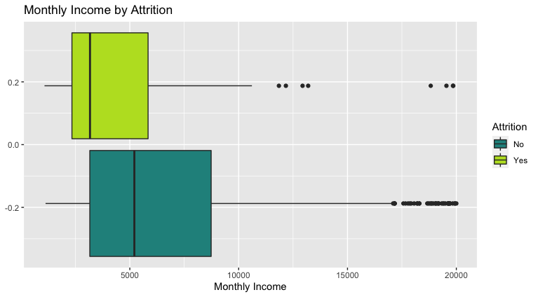
Monthly Income & Attrition
Mean Monthly Income
Separated Employees: 4765
Retained Employees: 6702
Two Sample t-test:
t = 4.62 (p < .0001)
Notes:
2nd important predictor
Mean monthly income of separated employees is 1,937 lower

Slide 5
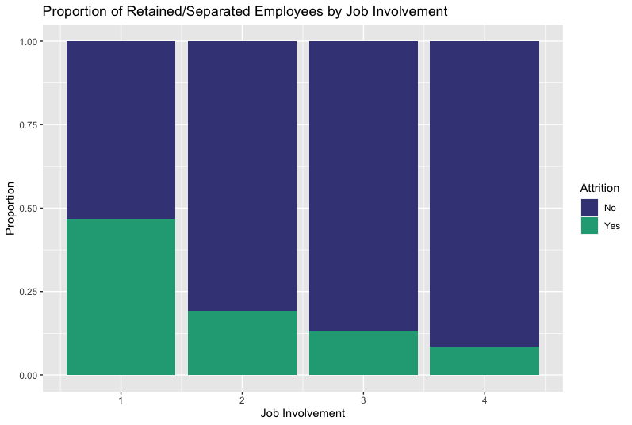
Attrition & Job Involvement
Proportion
1: 47%
2: 19%
3: 13%
4: 9%
Notes:
47% of employees w/ a JI score of 1
Lower JI seems to be associated w/ higher rates of attrition

Slide 6
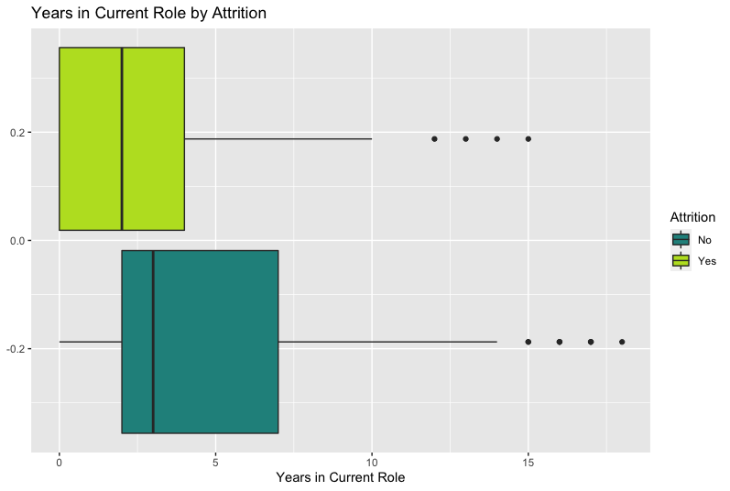
Attrition & Years in Role
Mean Years in Current Role:
Separated Employees: 2.9
Retained Employees: 4.5
Two Sample t-test
t = 4.45 (p < .0001)
Notes:
Promising factor to include in our model
separated employees Typically In current role for less time

Slide 7
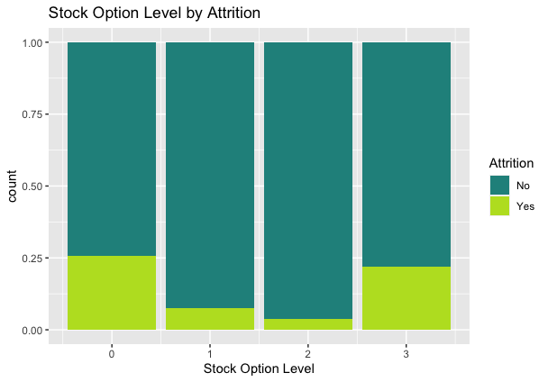
Stock Option Level & Attrition
Proportion:
0: 26%
1: 8%
2: 4%
3: 22%
Notes:
Stock option levels also differed in attrition rates

Slide 8
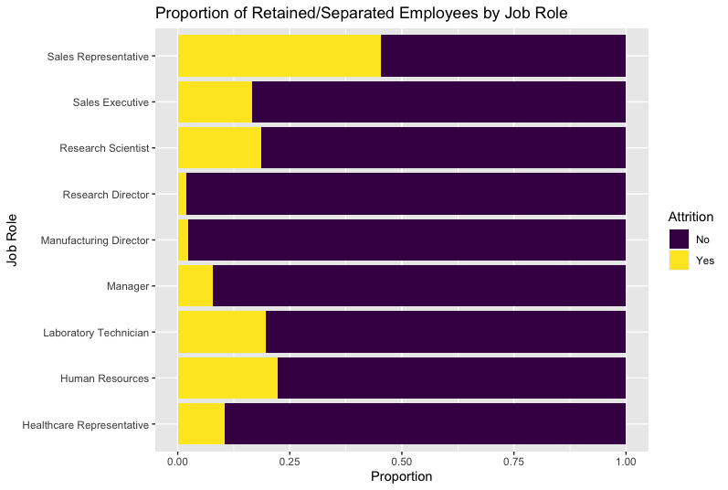
Attrition & Job Role
Proportion Separated:
Sales Rep: 24/53 (45%)
Human Resources: 6/27 (22%)
Lab Technician: 30/153 (20%)
Notes:
45% of sales reps separated
Quite a bit

Slide 9
Model to Predict Attrition
Variables used to predict:
Overtime
Monthly Income
Stock Option Level
Job Involvement
Years in Current Role
Model:
Naïve Bayes (probabilities)
Balanced model with downsampling
Mean Sensitivity: 68% (correct ID Retained)
Mean Specificity: 77% (correct ID Separated)
Better predictions of separated
Useful if incorrect ID of retained not as important
Notes:
Putting it all together, we used the top 5 predictors:
NB method – probab of these vars and attrition occurring
Our data was unbalanced – cause difficulty w/ predictions for attrition
Correct – technique - downsampling
Builds model from balanced training dataset – tested out on unbalanced test set

Slide 10
Additional Model to Predict Attrition
Variables used to predict:
Overtime
Monthly Income
Stock Option Level
Job Involvement
Years in Current Role
Total Working Years
Age
Job Level
Years at Company
Job Role
Years with Current Manager
Work Life Balance
Number Companies Worked
Model:
Naïve Bayes (probabilities)
Mean Sensitivity: 82% (correct ID retained)
Mean Specificity: 60% (correct ID separated)
Useful if incorrect ID of retained employees is problematic/expensive
Notes:
2ndary model
5 from previous model plus Total working…
Also developed using the NB method – this time no downsampling technique
This model could be useful if an attrition intervention measure is more expensive/time consuming
and it’s important that you don’t apply it to many employees who would have been retained anyway

Slide 11
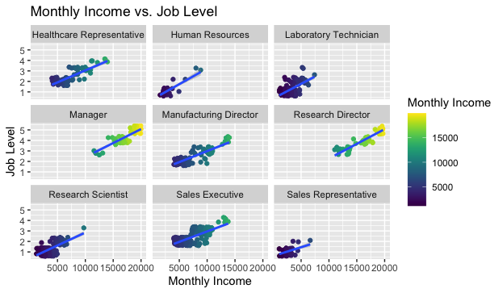
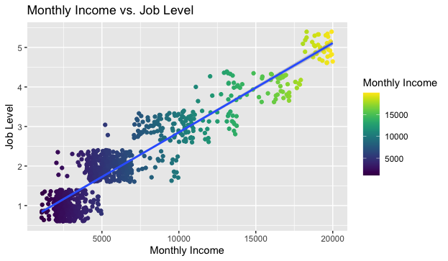
Monthly Income, Job Level & Role
Association between Monthly Income & Job Level
True for each job role
Notes:
Moving on from attrition, our next goal was to develop a model to predict monthly income
The ranges differ between job roles

Slide 12
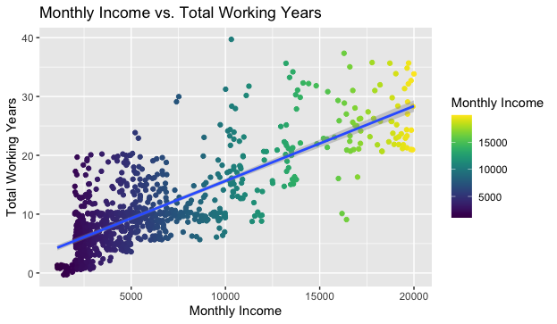
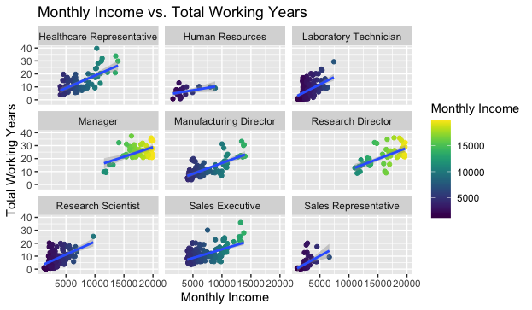
Monthly Income, Total Working Years & Job Role
Association between Monthly Income & Working Years
True for each job role

Slide 13
Predict Monthly Income
Variables used to predict:
Job Level
Total Working Years
Job Role
Model:
Linear Regression
Model explains 95% of variance in monthly income
Mean RMSE: 1067
Notes:
RMSE indicates how close the actual data is to the predicted values.
The smaller the # the better. Our goal <3000

Slide 14
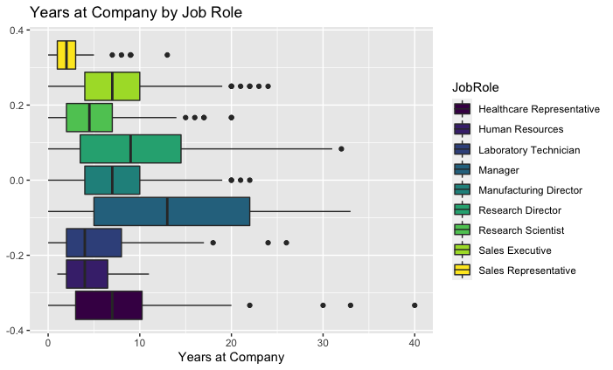
Job Roles: Sales Representatives
Sales Representatives
Mean years at company: 2.9
50% between 1-3 years
Higher rate of attrition
Lowest mean age
Lowest monthly income
Notes:
Next I’ll talk about some Additional trends and observations in the data set
During our attrition analysis, we noticed that sales reps differed somewhat from the other job roles
Further investigation – why so much turnover – quotas, lack of room for advancement, worth exploring why if goal is to reduce attrition?

Slide 15
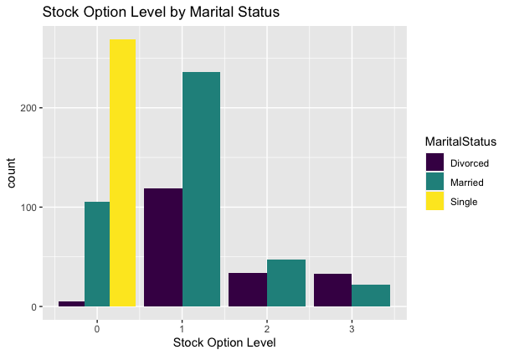
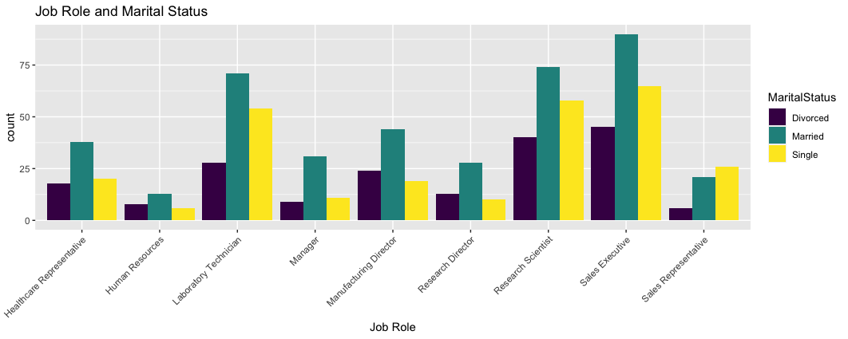
Stock Option Level
All single employees in Stock Option 0
All marital statuses in each job role
If voluntary, worth study
If only option, policy or oversight?
Notes:
When we were researching the relationship between stock options and attrition, we noticed something usual
At first we thought there might only be single employees in certain job roles or levels, but as you can see,

Slide 16
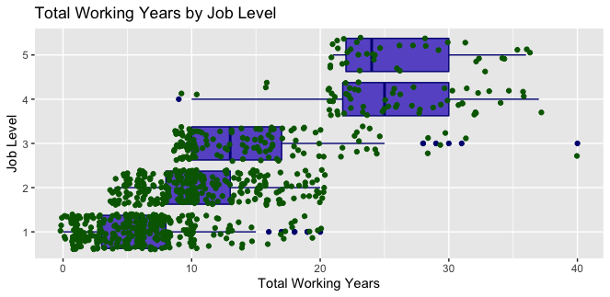
High Potential Employees
Working years associated with job level
A few long-term level 3
A few <20 years at level 4
Faster ascension
High potential?
Notes:
Finally, to identify high potential employees,
A few outliers who appear to be long term level 3 employees
**But, there are a few employees who have achieved a level four position with considerably less than 20 total working years
in one case less than 10
This indicates these particular employees may have high potential and would be worth noting.

Slide 17

Questions or Comments?
Notes:
That concludes my presentation.
I hope this has been helpful and thanks very much for your time!

